Slide 1
Ramon Emeterio Betances
Puerto Rican history

Slide 2
Introduction
Ramon Emeterio was a Puerto Rican independence advocate and medical doctor.
Born in April 8,1827, he became an intellect, an activist, and a scientist of the 19th century.
He is the father of the Puerto Rican independence movement.
He was influenced by the democratic ideals and the republicanism in the French Republic.
Notes:
Ramón Emeterio Betances Alacán (birth-Cabo Rojo, April 8, 1827-death: Paris, September 16, 1898) was an intellectual, scientist, and activist of the 19th century.
he was influenced by republicanism and the democratic ideals of the First French Republic (Mario).

Slide 3
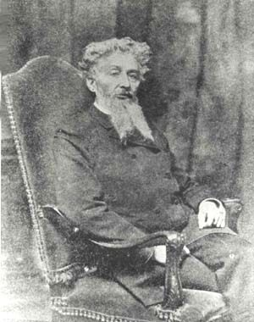
Impact on Puerto Rican History
He defended the separation and independence of Puerto Rico and a union of the Antilles.
Alongside Ruiz Belvis, he organized the Secret Society of Abolitionists that was functional between 1856 and 1857.
In 1864, he together with the Mayagüez Group, supported the Dominican Restoration War (1863-1865) and the
He was also present at the Revolutionary Committee of Puerto Rico in Santo Domingo, in 1867, which led to the insurrection of Grito De Lares in 1968.
Photo credit @Betances stem
Notes:
He defended the separation and independence of Puerto Rico and a union of the Antilles in a confederation capable of preventing foreign intervention in their sovereignty. Along with Ruiz Belvis, he was one of the organizers of the Secret Society of Abolitionists (1856-1857), of the Mayagüez group of 1864 in support of the Dominican Restoration War (1863-1865) and the Revolutionary Committee of Puerto Rico in Santo Domingo (1867), which led the armed insurrection known as the Grito de Lares (1868) (Mario)

Slide 4
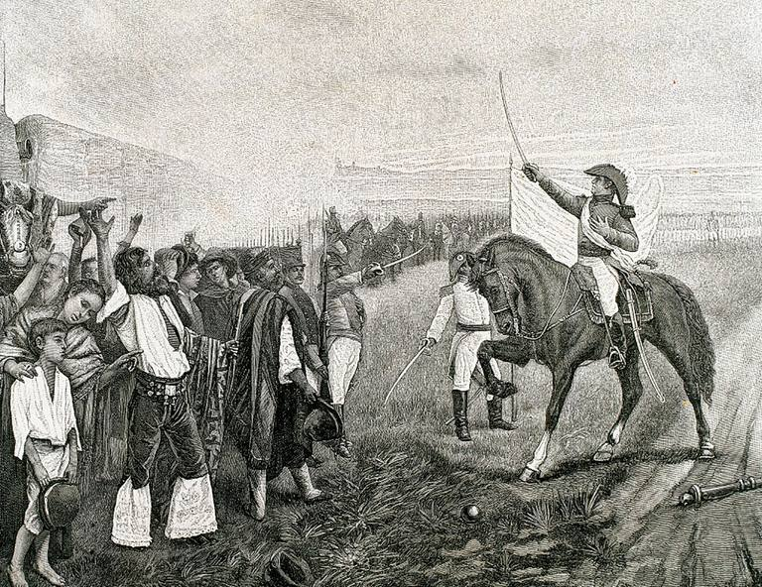
Impact on Puerto Rican History Cont…
He is also one of the founders of Puerto Rican academic medicine.
He facilitated the development of San Antonio Hospital and sponsored the establishment of a school in 1865.
Participated in the containment of Cholera epidemic by attending to 24, 000 residents in Puerto Rico.
Lobbied for the development of a slave camp and supplementary cemetery.
Photo credit @ ThoughtCo
Notes:
In scientific fields, he was a doctor and a surgeon, specializing in obstetrics, ophthalmology, urology and epidemiology in both tropical and temperate climates. He was interested in pharmacology, medical entrepreneurship and involved in a number of businesses related to health. He was considered one of the founders of academic medicine in Puerto Rico. His commitment to health was matched with his commitment to education. In Mayagüez, he helped found the San Antonio Hospital and promoted the establishment of a school in 1865, along with Segundo Ruiz Belvis (Mario)
Puerto Rico suffered a cholera epidemic that reached Mayagüez and affected a large part of the population. Betances, along with four other doctors, dedicated himself to attending to some 24,000 residents. Along with Dr. José Francisco Basora, he alerted and pressured the municipal government to take preventive actions such as burning slave quarters, because of their unhygienic and contaminated conditions. He also contributed to the creation of a temporary camp for slaves and a supplementary cemetery. Betances established and managed a temporary hospital that later became the San Antonio Hospital, the permanent municipal hospital in Mayagüez.

Slide 5
Independence from Spain
Ramon was a crucial figure in the Grito de Lares uprising.
He questioned the harsh treatment of slaves and lobbied for its abolition through the movement.
The Spanish governor of Puerto Rico threatened to exile him because of his abolitionist tactics.
He fled to the Dominican republic where he founded the Revolutionary Committee of Puerto Rico in 1868.
The committee spread across Puerto Rico for an eventual revolt against the Spanish colonialists.
Notes:
Betances began to question the causes for the inequalities that existed under a slave-owning colonial system. He was active in the movement to abolish slavery and in the anti-colonial movement. Betances and Segundo Ruiz Belvis founded the Revolutionary Committee of Puerto Rico on Jan. 6, 1868, while they were in exile in the Dominican Republic. Soon, revolutionary committees were formed throughout Puerto Rico to organize for an eventual revolt among all sectors of the population. Under the most secretive measures, organizers reached out to Africans who were toiling as slaves. The punishment for slaves caught in seditious activity was harsh (Rovira, 2005)

Slide 6
Independence from Spain
Through the Revolutionary Committee, Ramon galvanized the African slaves where the combatants fighting for Puerto Rican autonomy.
Other fighters were the Tainos descendants, the indigenous group of the island.
He bought rifles and weapons, among other weapons from the Dominican republic.
After being caught by the Spanish with the ship full of weapons, the rebels from the mountains executed the revolt ahead of schedule.
The war eventually led to the emancipation of the Puerto Ricans from Spain.
Notes:
Many of the Puerto Rican combatants galvanized by the revolutionary committees were former African slaves who had escaped and were living in hiding. Other freedom fighters were descendants of the Tainos, the original Indigenous people on the island who were living in the mountains and working as day laborers in the towns.
Betances bought rifles, cannons and other weapons in the Dominican Republic. But the Spanish colonial authorities discovered the plans. On his return from the neighboring island nation as his ship entered the harbor of Arecibo, the Spanish Navy surrounded the rebel ship, capturing the cargo and arresting the crew.
News of the ship’s capture reached the revolutionaries in the mountains who were preparing for the rebellion. With Betances in Spanish custody, the leading organizers of the movement decided to call for the rebellion ahead of schedule (Rovira, 2005)

Slide 7
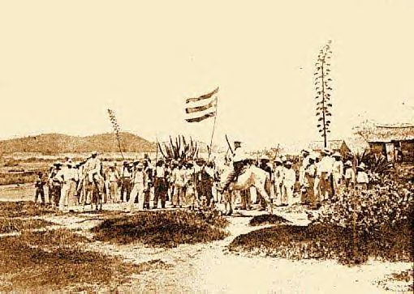
Photo credit @margaritamaldomado

Slide 8
References
Mario, C. Ramón Emeterio Betances. Enciclopedia De Puerto Rico. Retrieved from https://enciclopediapr.org/en/encyclopedia/ramon-emeterio-betances/
Rovira, C. (2005). The Birth of Puerto Rico’s Fight for Independence. Liberation. Retrieved from https://www.liberationnews.org/05-09-01-the-birth-puerto-ricos-fight-in-html/

